Slide 1
Company profile
Company profile
Qingdao C & M Bearing Co.,ltd
Nature of the company: wholly foreign-owned
Date of establishment: 2003
Floor area: 60,000 m2
Building area: 13,400 m2
Number of employees: 78 Investment capital: $10 million
Location: Henan Village, Nancun Town, Pingdu City, Qingdao, Shandong Province
The company has first-class production line and advanced testing equipment, a strong production lineup, strong technical force, adhere to the market-oriented, people-oriented, quality for survival, innovation for development, strengthen internal management, timely adjustment of product structure, to provide our customers with first-class products and quality services。

Slide 2
Company Events
2003
2008
2009
2011
2020
2021
2013
2019
2016
2006
The Company is built
IATF16949 certification
IATF16949 certification
A new plant in Pingdu city goes into operation
Development and production of carbon steel ball product
Enter the SKF supplier list
Purchase AVIKO appearance selection machine and put into production
Establish a constant temperature and humidity laboratory
ISO14001 certification
Purchase heat treatment automatic production line
High-tech Enterprise Certification

Slide 3
Organization chart
General Manager
Factory Director
Administration office
Production technology Department
Quality Department
Business Department
Heading
Flashing
Heat treatment
Grinding
Lapping
Sorting & Packing

Slide 4
Core member
Production technology Dept
Quality dept
General Manager
Production management
Technical support for equipment maintenance and modification
APQP team member
Customer feedback processing
APQP team member
team for product quality control and inspection
Factory Director
Management of enterprise development strategy and business plan
Organize and implement various work of the company
Resource Management
APQP team member
Assist General Manager in all matters
The production management
IATF16949 quality management system operation and maintenance.
ISO1400 environmental management system operation and maintenance;
Environment, production safety, occupational health management.
APQP team member
Customer communication
Order Management
Administration office
Internal and external communication and coordination
Human resource management
Transportation coordination management
Logistics Service Management

Slide 5
Company personnel distribution

Slide 6
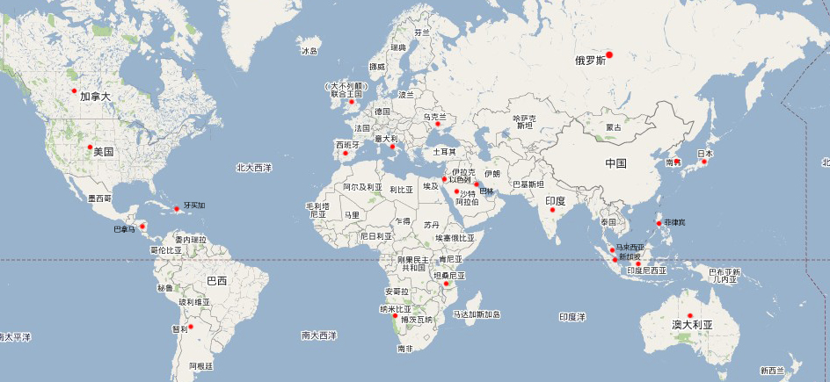
营销网络
Regional distribution ：
Proportion:
Total sales in recent 5 years (ten thousand yuan)

Slide 7
Customer list and share
PARKWON
SANSEI
CIMAP
BRBC
KITAGAWA
TRCW
AUTOLIV
Others

Slide 8
Production
Name：
Material：
Size：
Grade：
capacity：
Stainless steel ball
SUS 420/440/304/316l
1/16”– 1”
G1000-G40
500 Ton/Year
Name：
Material：
Size：
Grade：
capacity：
Chrome steel ball
GCr15/SUJ-2
1/16”– 2”
G1000-G10
4800 Ton/Year
Name：
Material：
Size：
Grade：
capacity：
Carbon steel ball
Q235/SWCH15
1/16”– 2”
G1000-G20
1200 Ton/Year
Others：
Material：
Size：
Grade：
capacity：
Other balls
Ceramic/Brass/Aluminum
1/16”– 2”
G1000-G20
1200 Ton/Year

Slide 9
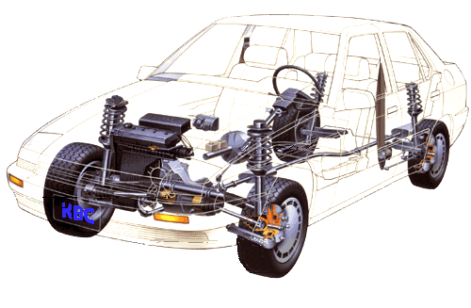
产品应用范围
C.V Joint Application
Safety Belt Application
Plastic Fuel Systems
Engine Application
Bearing
Seat Slide Application
Fuel Spray Nozzle
Steering Application

Slide 10
Process Flow
Raw Materail
Packing
Heading
Flashing
Heat Treatment
Grinding
Lapping
Cleaning
Sorting
Inspection
Shipment

Slide 11
Production equipment
Heading machine:
Made in Korea
Made in China
Grinding machine:
Made in China
Quantity：32
Quantity：24
Flashing machine:
Flashing machine:
Made in China
Quantity：24
Quantity：25
Lapping Machine:
Made in China
Quantity：65
Ultrasonic Cleaners:
Made in China
Packing Machine:
Made in China
Quantity：4
Quantity：1
Sorting Machine:
Made in China
Quantity：32

Slide 12
Inspection room
Constant temperature and humidity laboratory
Spectrum Analyzer
Roundness Test
Roughness Test
Hardness Test
Dimension check
Metallographic analysis

Slide 13
Enterprise Honor

Slide 14
Management System

Slide 15
结束
Thanks !!!

